Slide 1

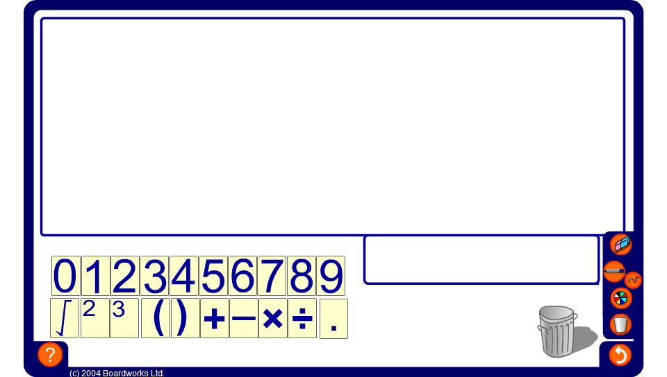


Positioning brackets
Notes:
Explain to pupils that the positioning of brackets is important.
Demonstrate this by positioning a single pair of bracket in the expression 1 + 3 × 5 – 4 ÷ 2. Many different answers are possible.
For example,
(1 + 3) × 5 – 4 ÷ 2 = 18
(1 + 3 × 5 – 4) ÷ 2 = 6
1 + (3 × 5 – 4) ÷ 2 = 6.5
1 + 3 × (5 – 4) ÷ 2 = 2.5
1 + 3 × (5 – 4 ÷ 2) = 10
Ask pupils to suggest possible positions for the brackets.
Alternatively, ask pupils to position the brackets to make a given answer.

